Slide 1
Inline AD Introduction
Tan Peng
2019/05/22

Slide 2
Current AD Team
Tan Peng
Zhou Siqi
Khoo Kaiqin
Beverly

Slide 3
Agenda
Background
Manual OOC root cause analysis
Inline AD analysis and ORION AD analysis
Challenges and Future Plan

Slide 4

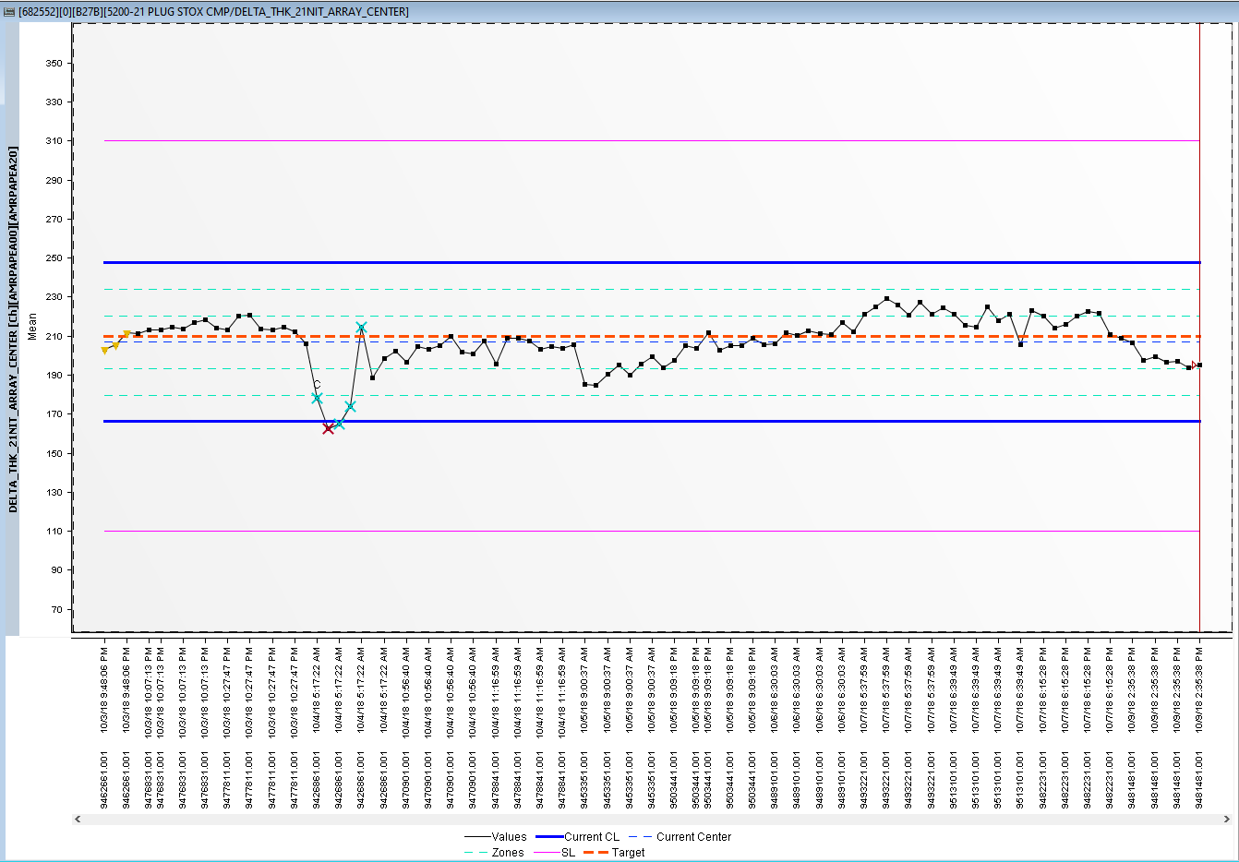
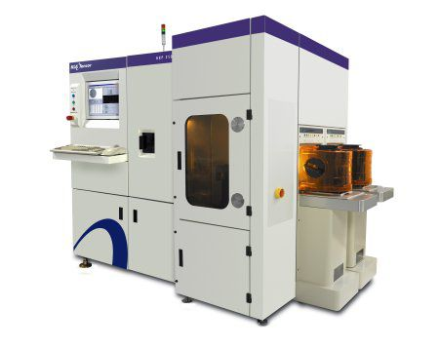

Inline Auto Diagnostics
Background
SPACE Charts
SPC

Slide 5
Inline Auto Diagnostics
Background
Out-of-Control
(OOC) Limit
Out-of-Control
(OOC) Points

Slide 6

Inline Auto Diagnostics
Background
What is the root cause of these OOCs?

Slide 7


Manual Diagnostics
How engineers normally do the diagnostics?
SPACE Match
FMEA
Domain
Tool Commonality
Incoming measurement drift
Important tool parameters
Qual History
PM/CM Records
R2R Tuning History
SWR/Conversion

Slide 8
Overall Inline AD Flow
Search Charts to Analysis
Collect SPACE data/Sigma data and other data
Perform AD Analysis
Generate AD Report
Daily Scan,~6 hour data latency, each report generation takes ~5 min

Slide 9
Overall ORION AD Flow
eCAP Trigger
Collect data from stream cluster
Perform AD Analysis
Generate AD Report
Triggering based, ~15 min data latency, each report generation takes < 3 min

Slide 10



Search Charts to Analysis
Collect data
AD Analysis
Generate Report
SPC Hive Table
Find Channel/CKC has OOC in
Past 24 hours
Channel 123456, CKC 0
Channel 123458, CKC 1
…

Slide 11
Search Charts to Analysis
Collect data
AD Analysis
Generate Report
HBase
Sigma
Tool
Recipe
…
Teradata
SWR
QDR
Lot Attribute
PM/CM Records
Wafer Genealogy
Reference File
FMEA step list
Domain
Domain step
Past Feedback

Slide 12
Search Charts to Analysis
Collect data
AD Analysis
Generate Report
After collecting all data, we need to manipulate the data into an analysis-friendly format
Lot_id | Wafer_id | Label | Step1 tool1 | Step1 tool2 | Step1 recipe1
1234567.001 | 4567-01 | 0 | 1 | 1 | 1
1234567.001 | 4567-02 | 1 | 0 | 0 | 0
1234568.001 | 4568-02 | 0 | 1 | 0 | 1
1234569.001 | 4569-01 | 1 | 1 | 1 | 0

Slide 13
Search Charts to Analysis
AD Analysis
Generate Report
Collect data
We try to find the “best” item correlated to OOC
Lot_id | Wafer_id | Label | Step1tool1 | Step1tool2 | step1recipe1
1234567.001 | 4567-01 | 0 | 1 | 1 | 1
1234567.001 | 4567-02 | 1 | 0 | 0 | 0
1234568.001 | 4568-02 | 0 | 1 | 0 | 1
1234569.001 | 4569-01 | 1 | 1 | 1 | 0

Slide 14

Search Charts to Analysis
AD Analysis
Generate Report
Collect data
Time Weighted Correlation (Link)
Equal weighted
Time weighted

Slide 15
Search Charts to Analysis
AD Analysis
Generate Report
Collect data
Categorize step
Top 3 correlation from each category are selected
FMEA
Past Lesson Step
Process Step
Measurement Step
At Loop
Incoming
Domain Step

Slide 16
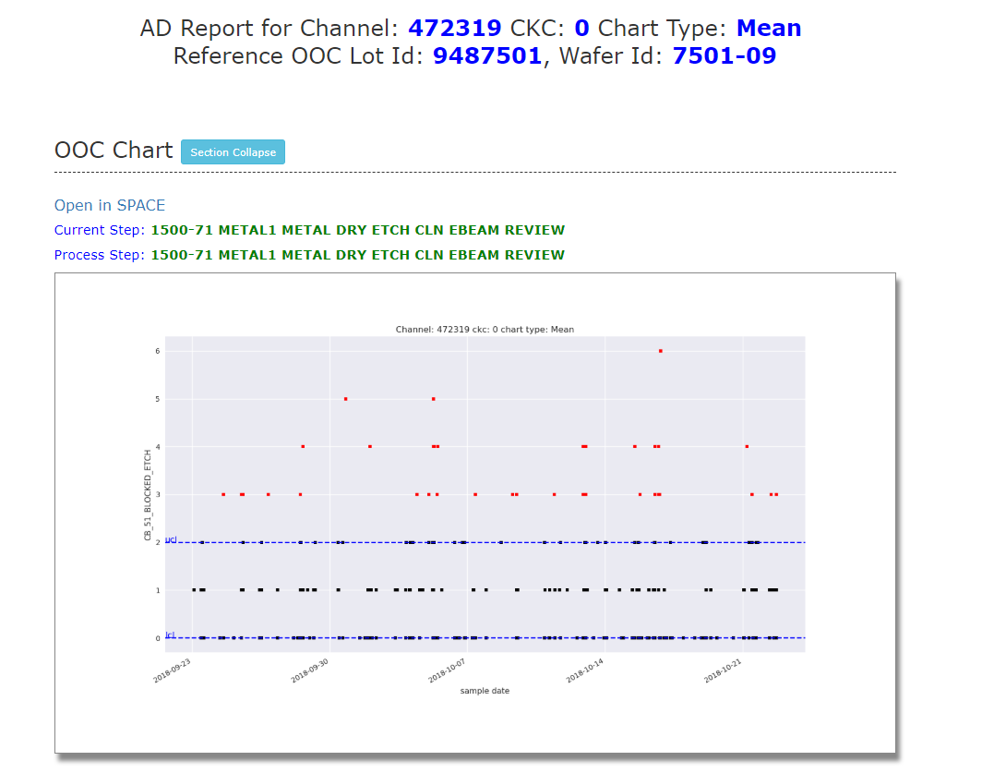
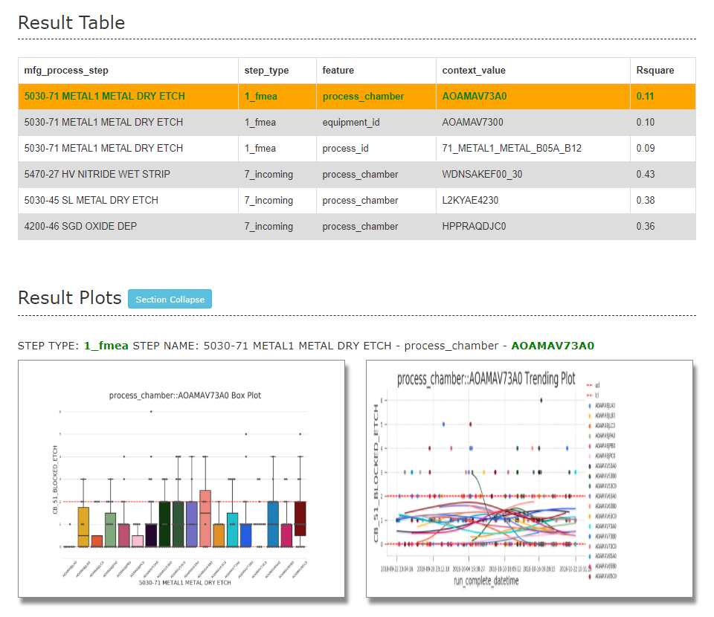
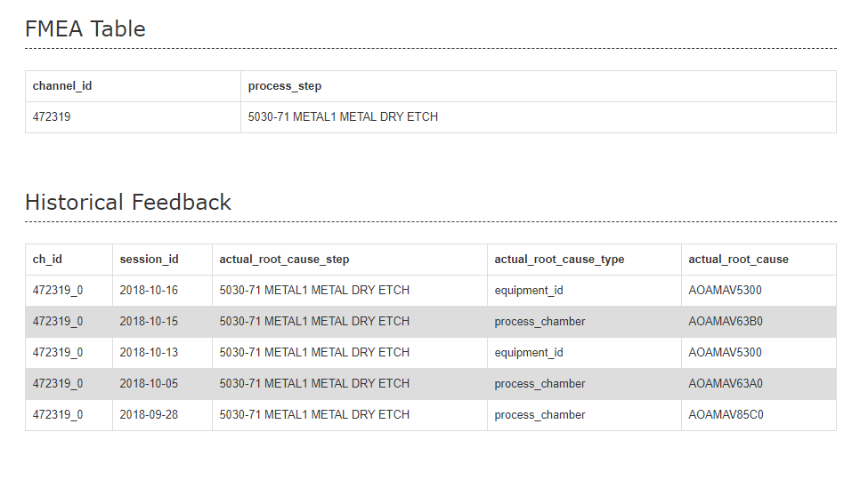
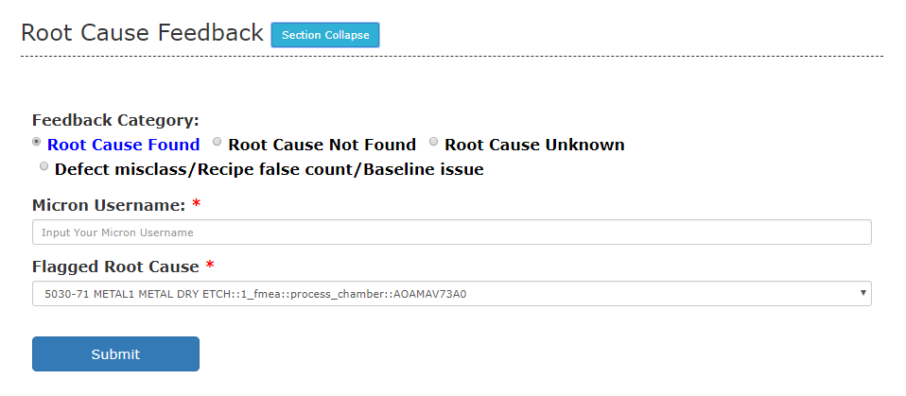
Search Charts to Analysis
Collect data
AD Analysis
Generate Report

Slide 17
Search Charts to Analysis
Collect data
AD Analysis
Generate Report
Feedback system is embedded into this report
Result will send back to MSSQL to track.

Slide 18
Challenges
Too many potential root causes
Prefer ad-hoc analysis
Reduce data latency and analysis time further

Slide 19
Future Plan
Limit potential root causes number < 3
Focus on ORION AD
R2R Tuning History
Use eCAP closure information as knowledge base

Slide 20
Appendix
Confluence Page
http://f10adintro/
Code Repo
https://bitbucket.micron.com/bbdc/projects/FDS/repos/chronic_ad_v2/browse
We build a few python packages/API to quick query space/sigma/lot attribute etc..
Dashboard
https://tableau-apac/#/site/F10FEMFG/views/F10_QM69A_V2_RDA_OOC_SUMMARY/AD?:iid=1
https://tableau-apac/#/site/F10FEMFG/views/F10_CHRONIC_OOC_AD_SUMMARY/ChronicAD?:iid=1

Slide 21


